Slide 1
Computer Vision and Deep Learning
Lecture 12

Slide 2
Final exam
CVDL (coggle.it)

Slide 3
EEML summer school
https://www.eeml.eu/home

Slide 4
Foundation models
Foundation models are a promising development that can perform zero-shot and few-shot learning for new datasets and tasks often by using “prompting” techniques

Slide 5
CLIP
Learning Transferable Visual Models From Natural Language Supervision

Slide 6
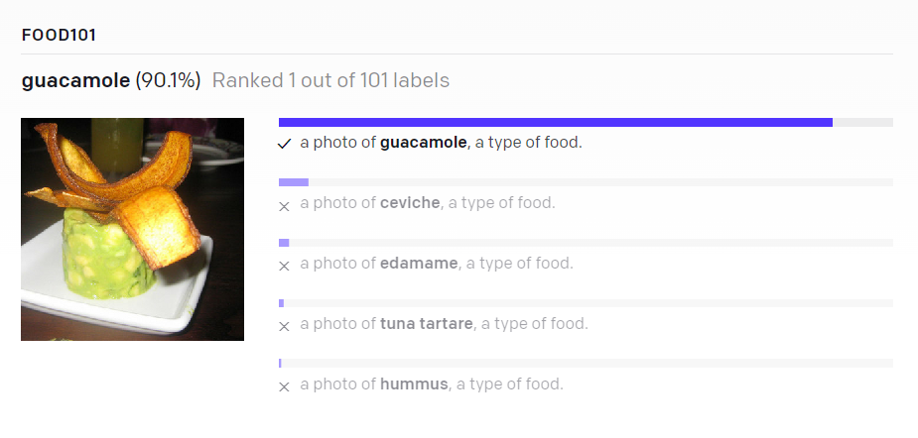
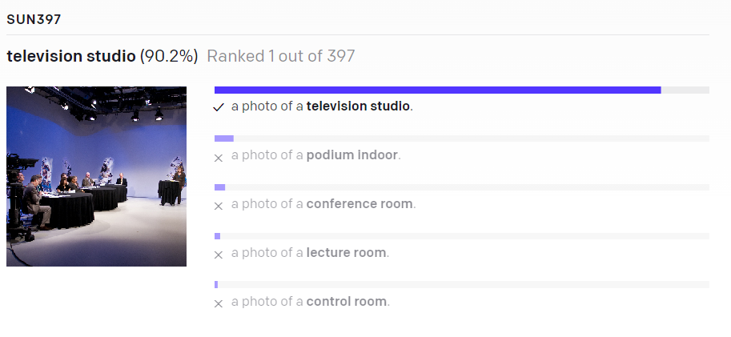
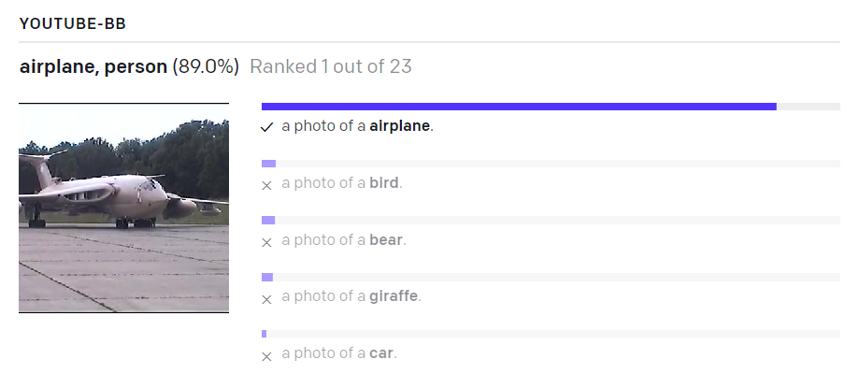
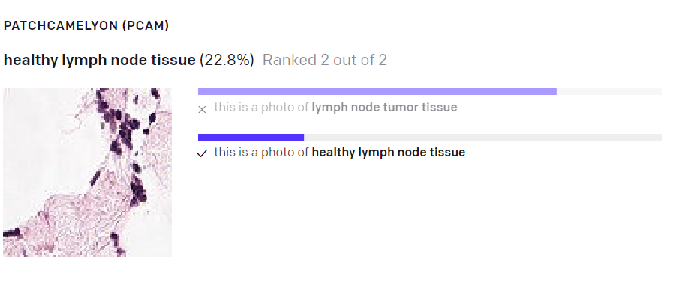
CLIP

Slide 7
Learning Transferable Visual Models From Natural Language Supervision
CLIP
https://arxiv.org/pdf/2103.00020.pdf

Slide 8
CLIP
Uses a contrastive loss to unify text and images together
During pre-training, align images with textual descriptor
Zero-shot image classification
Trained on 400 million image-text pairs from the internet.
CLIP was trained on 256 V100 GPUs for two weeks (AWS Sagemaker ~200k $)
The batch size for the input is 32768.

Slide 9
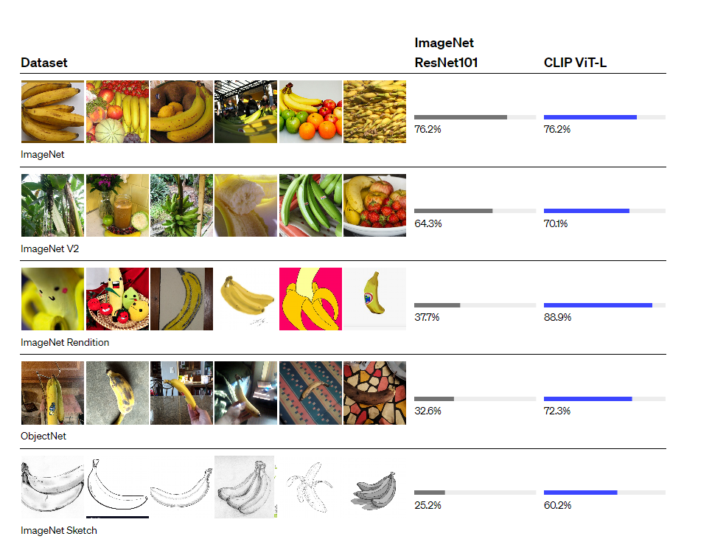

Slide 10
CLIP
“Classic” classification
Costly datasets: The ImageNet dataset, one of the largest efforts in this space, required over 25,000 workers to annotate 14 million images for 22,000 object categories.
Narrow: can only predict the known classes (e.g. 1000 ImageNet categories)
Poor real-word performance: cheating, “memorizing” the dataset

Slide 11
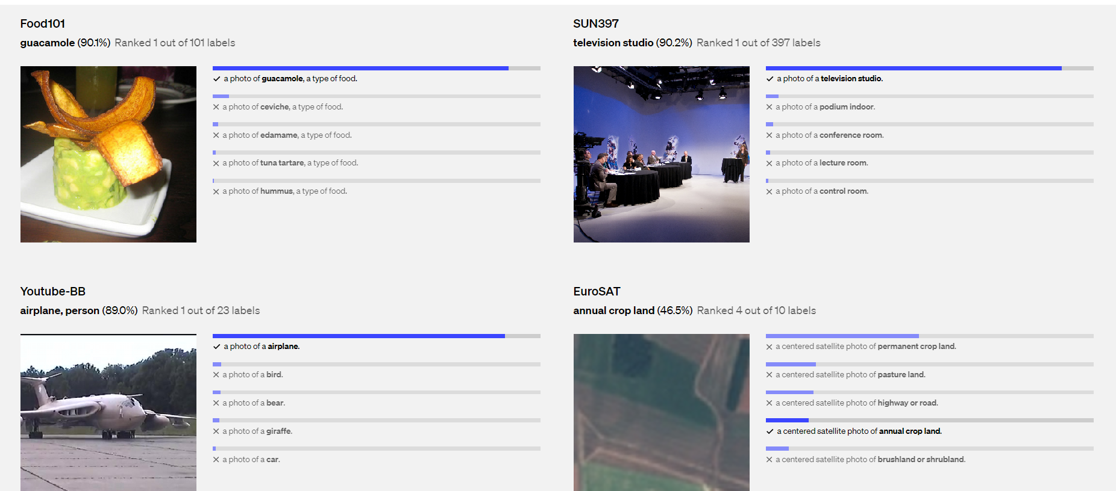
CLIP

Slide 12
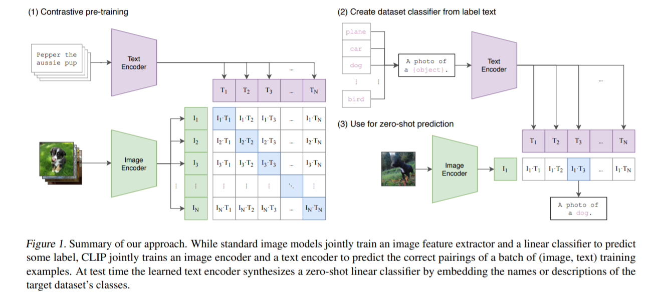
CLIP
https://www.youtube.com/watch?v=u0HG77RNhPE

Slide 13
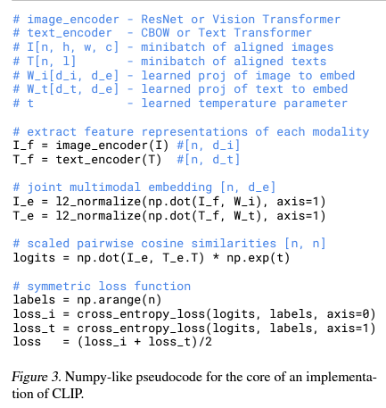
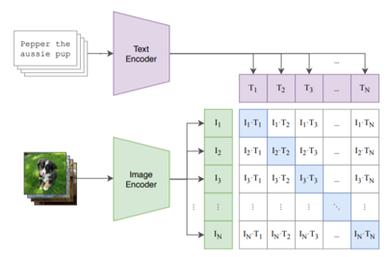
CLIP
Jointly trains an image encoder and text encoder to maximize the cosine similarity of the image and text embeddings of the N real pairs in the batch while minimizing the cosinesimilarity of the embeddings of the N²−N incorrect pairings

Slide 14
CLIP limitations
Struggles on more abstract or systematic tasks such as counting the number of objects in an image and on more complex tasks such as predicting how close the nearest car is in a photo
Poor generalization to images not covered in its pre-training dataset
MNIST dataset, zero-shot CLIP only achieves 88% accuracy, well below the 99.75% of humans on the dataset

Slide 15
SAM: Segment Anything
Online demo: https://segment-anything.com/demo
https://segment-anything.com (Apache license)
https://arxiv.org/abs/2304.02643

Slide 16
SAM
Foundation model for image segmentation: a promptable model and pre-trained it on a broad dataset using a task that enables powerful generalization.
Three aspects: task, model and data
What task will enable zero-shot generalization?
What is the corresponding model architecture?
What data can power this task and model?

Slide 17
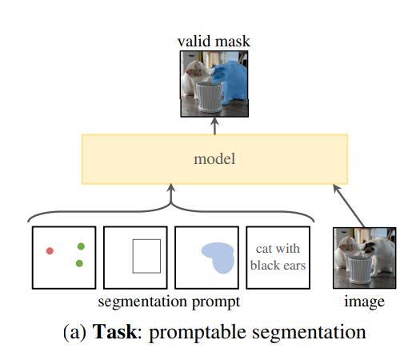
SAM Task
Promptable segmentation task: the goal is to return a valid segmentation mask given any segmentation prompt
Prompt: points, bboxes, text
Valid mask: even for ambigous prompts the output should be a reasonable mask for at least one of those objects

Slide 18
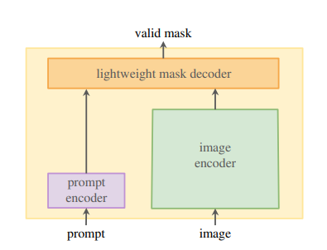
SAM Model
Requirements:
flexible prompts
compute masks in amortized (interactive use)
must be ambiguity-aware
Solution
Independent image and prompt encoders
lightweight mask decoder that predicts segmentation masks
~ 50 ms in a web browser

Slide 19
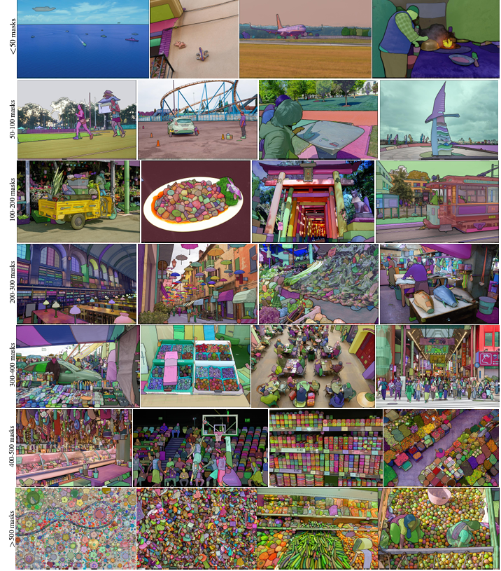
SAM Dataset
build a “data engine”: model-in-the-loop dataset annotation
SA-1B dataset: 1B masks from 11 M images
400× more masks than any existing segmentation dataset; high quality and diverse masks

Slide 20
SA-1B dataset annotation
3 stage annotation
Assisted Manual: Annotators annotate alongside SAM to pick all masks in an image.
Semi-Automatic: Annotators are asked to only annotate masks for which SAM cannot render a confident prediction.
Full-Auto: SAM is allowed to fully predict masks given it's ability to sort out ambiguous masks via a full sweep.
a regular grid of foreground points, yielding on average ∼100 high-quality masks per image

Slide 21
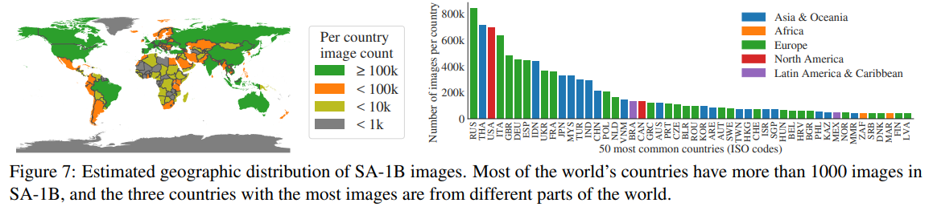
SA-1B dataset features

Slide 22
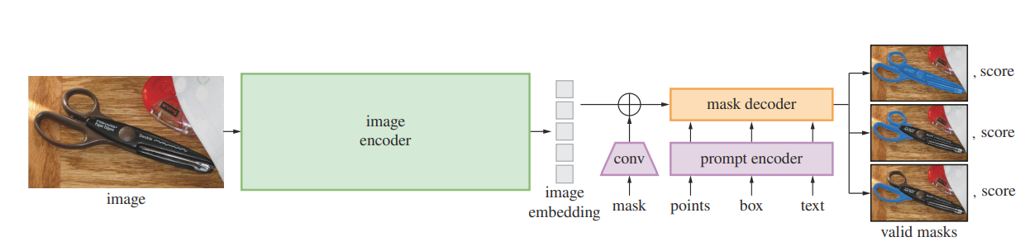
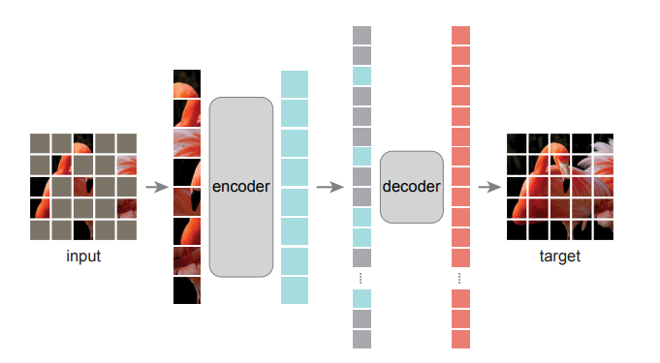
SAM Architecture breakdown
MAE pre-trained Vision Transformer (ViT)
runs once per image and can be applied prior to prompting the model
MAE

Slide 23
SAM Architecture breakdown
Prompt encoder:
Points:
positional encoding for (x, y) position+ trained embedding for fg/bg
BBoxes
Positional encoding + embedding fw/bg for top left point
Positional encoding + embedding fw/bg for bottom right point
Text: CLIP text embeddings

Slide 24
SAM Architecture breakdown
Mask decoder: maps the image embedding and a set of prompt embeddings to an output mask
Mask decoder uses modification of a Transformer decoder block followed by a dynamic mask prediction head.
The block uses prompt self-attention and cross-attention in two directions (prompt-to-image embedding and vice-versa)

Slide 25
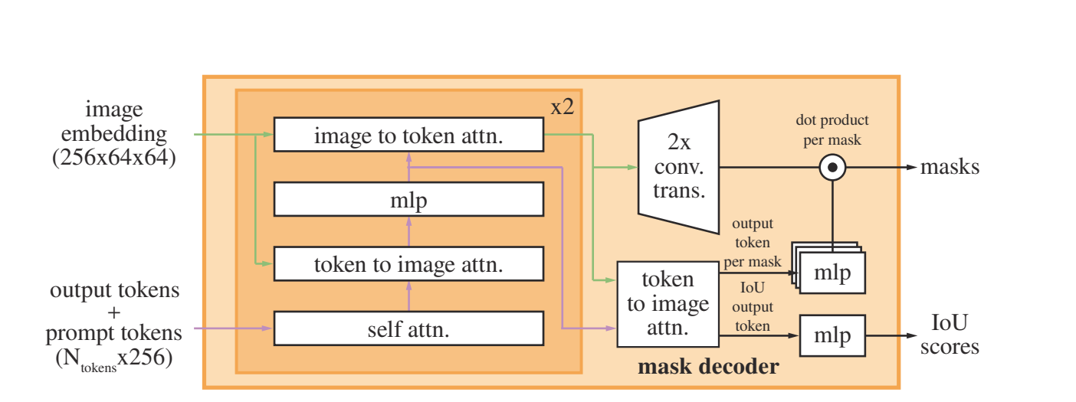
SAM Architecture breakdown – Mask encoder
insert into the set of prompt embeddings a learned output token embedding that will be used at the decoder’s output, analogous to the [CLS]

Slide 26
SAM Architecture breakdown
Transformer decoder
(1) SA on the tokens
(2) cross-attention from tokens (as queries) to the image embedding
(3) MLP updates each token
(4) cross-attention from the image embedding (as queries) to tokens

Slide 27
SAM Architecture breakdown
To ensure the decoder has access to critical geometric information the positional encodings are added to the image embedding whenever they participate in an attention layer
The entire original prompt tokens (including their positional encodings) are re-added to the updated tokens whenever they participate in an attention layer

Slide 28
SAM Architecture breakdown – Mask encoder
“Prompt aware image embeddings”
- Upsampled by 4× with two transposed convolutional layers

Slide 29
SAM Architecture breakdown – Mask encoder
“Image aware prompt embeddings”
the tokens attend once more to the image embedding
passed to a small 3-layer MLP that outputs a vector matching the channel dimension of the upscaled image embedding

Slide 30
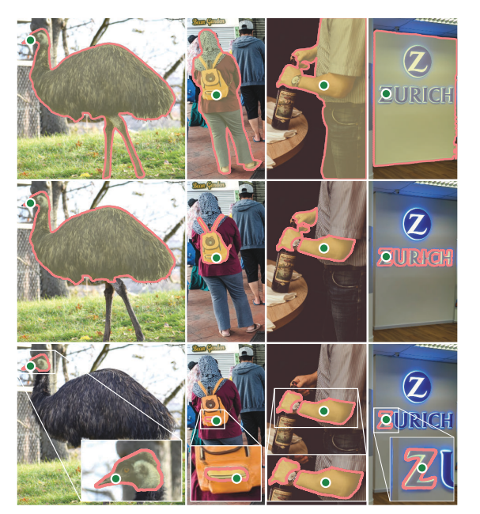
SAM Resolving ambiguity
With one output, the model will average multiple valid masks (ambiguous prompt)
Model predicts 3 output masks
Whole
Part
Subpart

Slide 31
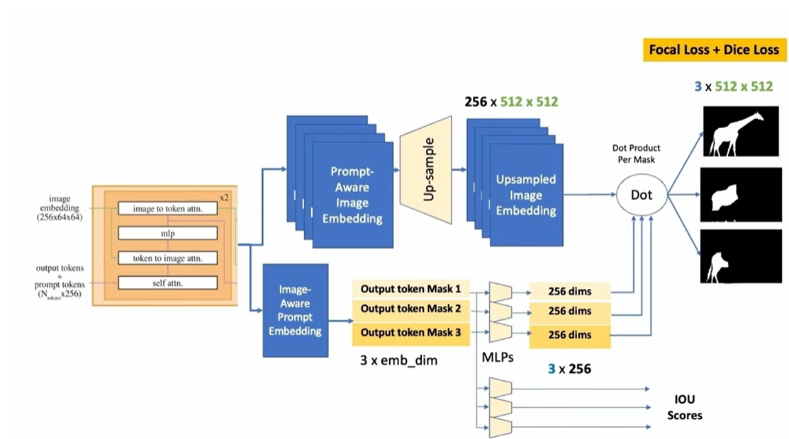
SAM

Slide 32
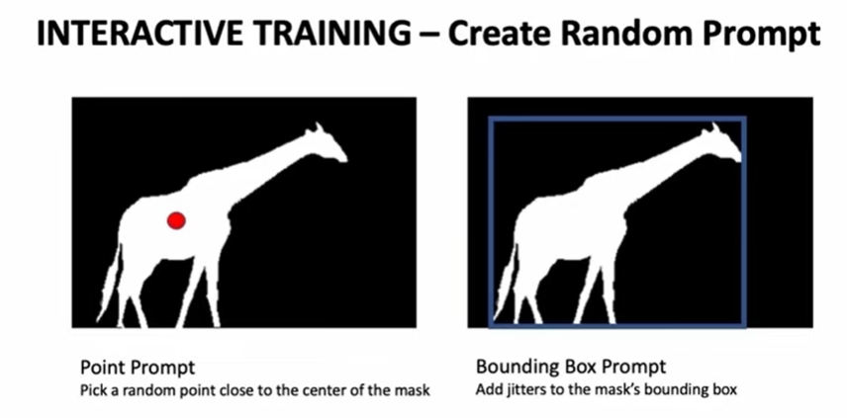
Interactive training Round 1
https://www.youtube.com/watch?v=OhxJkqD1vuE

Slide 33
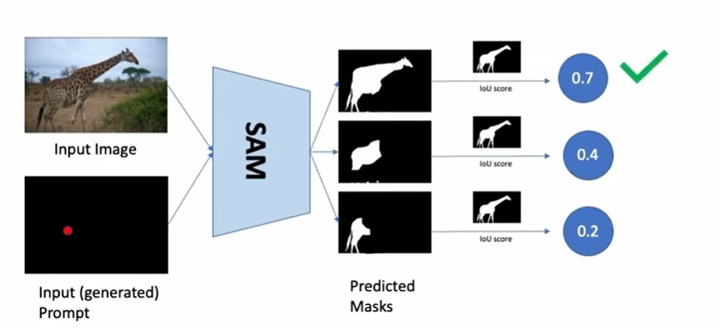
Interactive training Round 1
https://www.youtube.com/watch?v=OhxJkqD1vuE

Slide 34
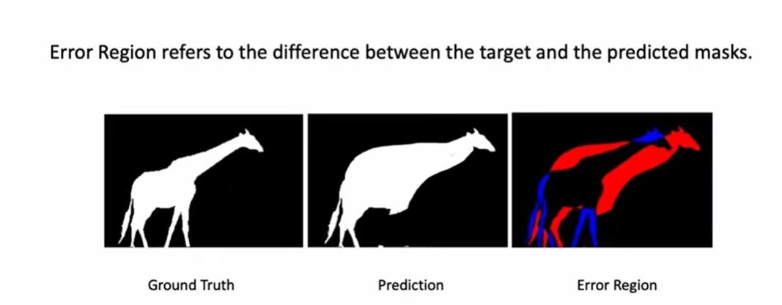
Interactive training Round 1
Sample a point from the error region, and input it into the network as a new point prompt
https://www.youtube.com/watch?v=OhxJkqD1vuE

Slide 35
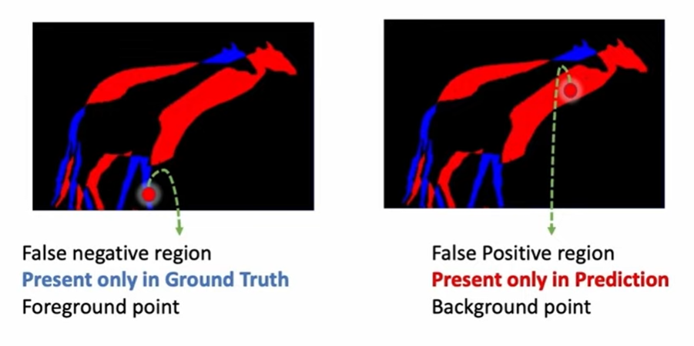
Interactive training
https://www.youtube.com/watch?v=OhxJkqD1vuE

Slide 36
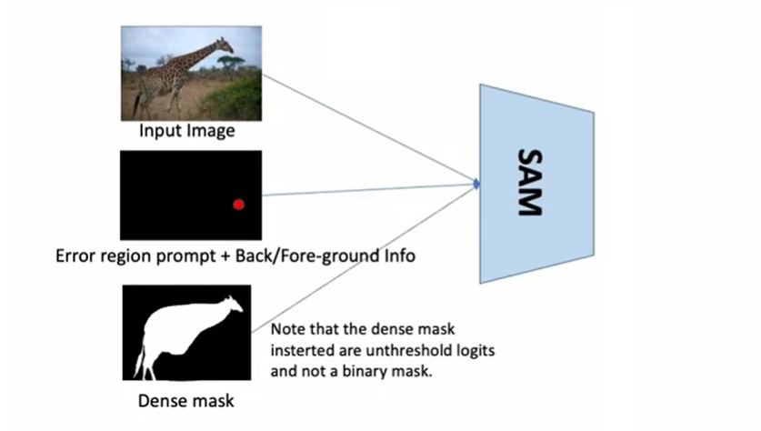

Interacting training Round 2…

Slide 37
Interactive training
In total 11 total iterations:
one sampled initial input prompt
8 iteratively sampled points (8 found empirically)
two iterations where no new external information is supplied to the model so it can learn to refine its own mask predictions
One of these iterations is randomly inserted among the
8 iteratively sampled points, and the other is always at the
end.

Slide 38
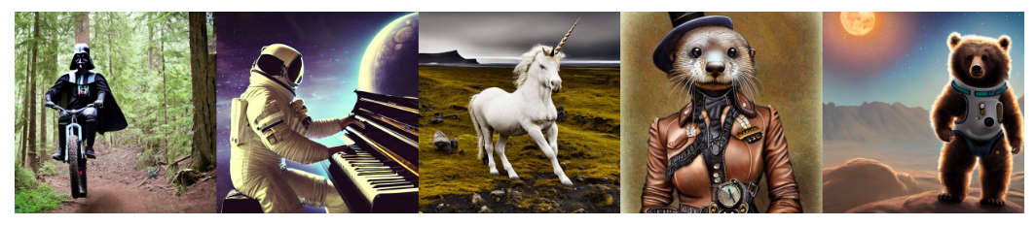
STABLE DIFUSSION
https://arxiv.org/abs/2112.10752

Slide 39
Stable diffusion
https://www.youtube.com/watch?v=kVpDARqZdrQ&t=113s&ab_channel=AndrejKarpathy
https://www.youtube.com/watch?v=sM9bozW295Q&ab_channel=AndrejKarpathy
https://www.youtube.com/watch?v=Jv1ayv-04H4&ab_channel=AndrejKarpathy

Slide 40
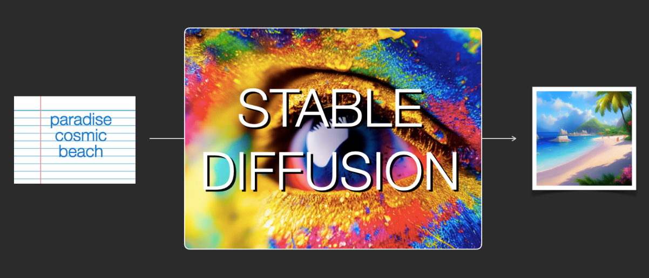
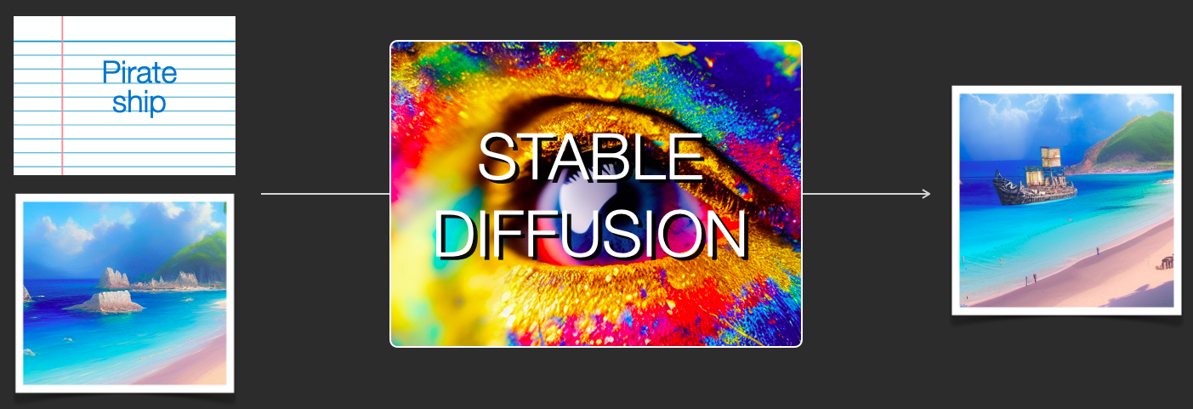
Stable diffusion
Image source: https://jalammar.github.io/illustrated-stable-diffusion/

Slide 41
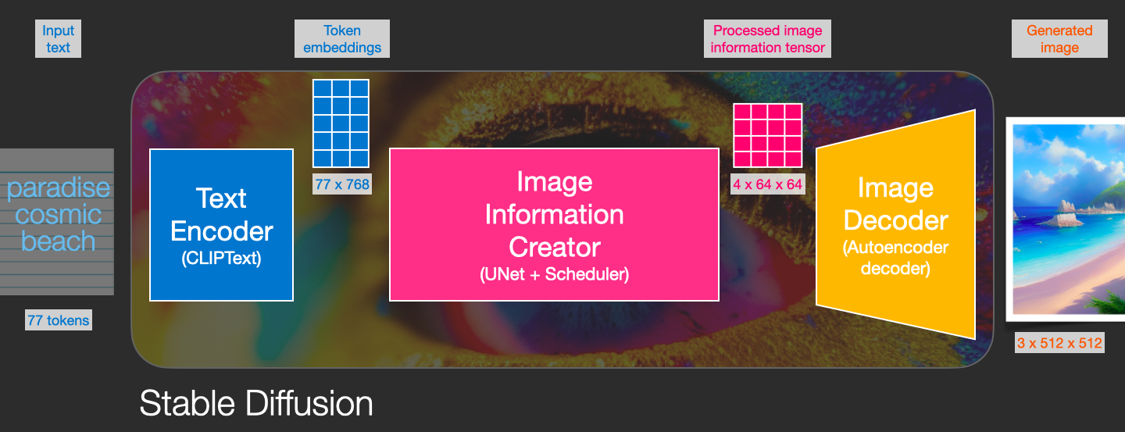
Stable diffusion
Image generator
Image source: https://jalammar.github.io/illustrated-stable-diffusion/

Slide 42
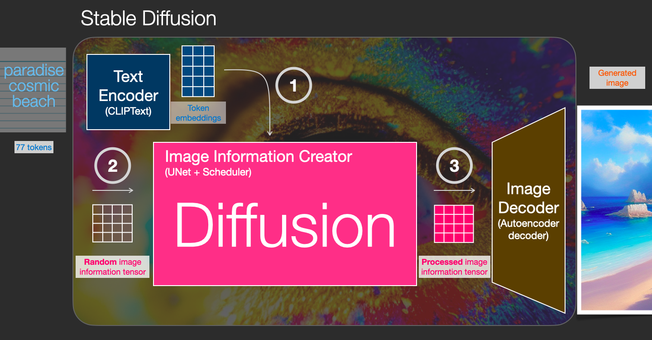
Stable diffusion
Gradually process/diffuse information in the information (latent) space. Input: text embeddings & tensor up of noise.
Image source: https://jalammar.github.io/illustrated-stable-diffusion/

Slide 43
Stable diffusion
creates the final image using the processed information array from the diffusion model
Image source: https://jalammar.github.io/illustrated-stable-diffusion/

Slide 44
Stable diffusion
Diffusion
Start with a random image and noise and packs into it information as dictated by the text embedding and all the visual information the model picked up from all images the model was trained on
Sequential process, each step adds more information
https://jalammar.github.io/images/stable-diffusion/diffusion-steps-all-loop.webm
https://jalammar.github.io/images/stable-diffusion/stable-diffusion-steps-2-4.webm

Slide 45
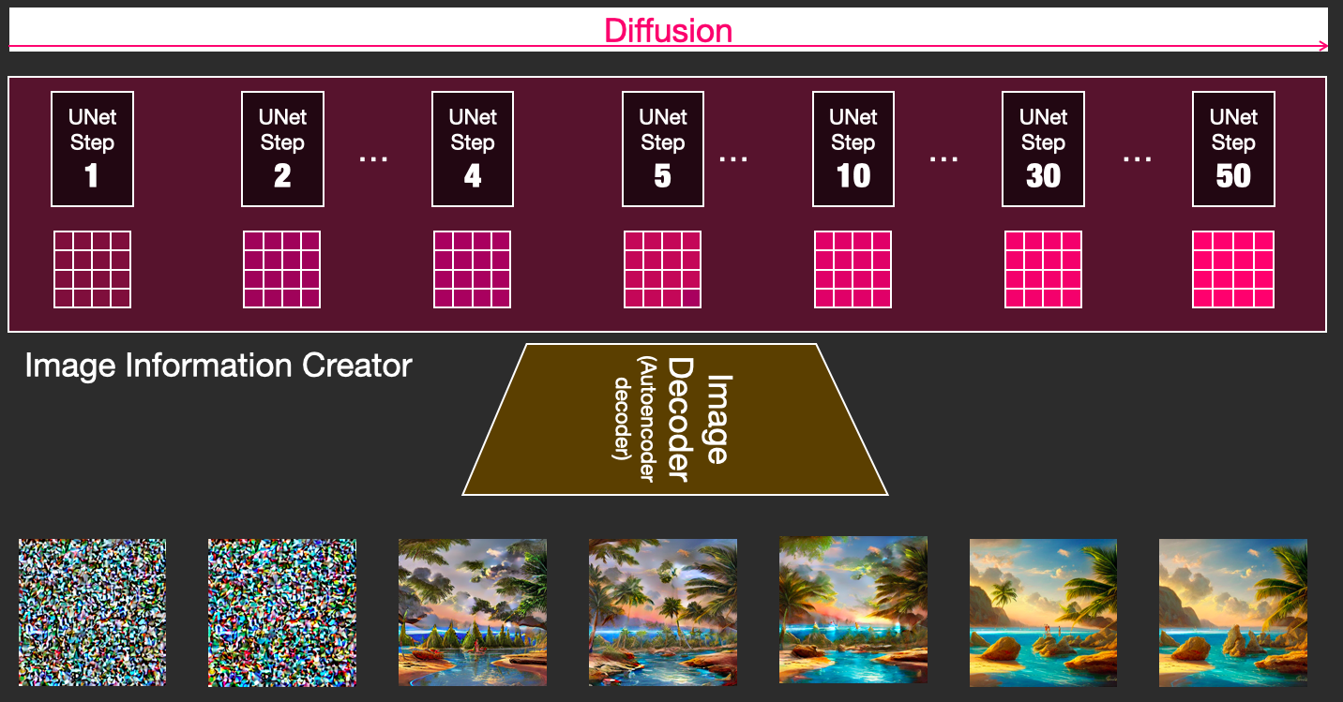
Stable diffusion
Image source: https://jalammar.github.io/illustrated-stable-diffusion/

Slide 46
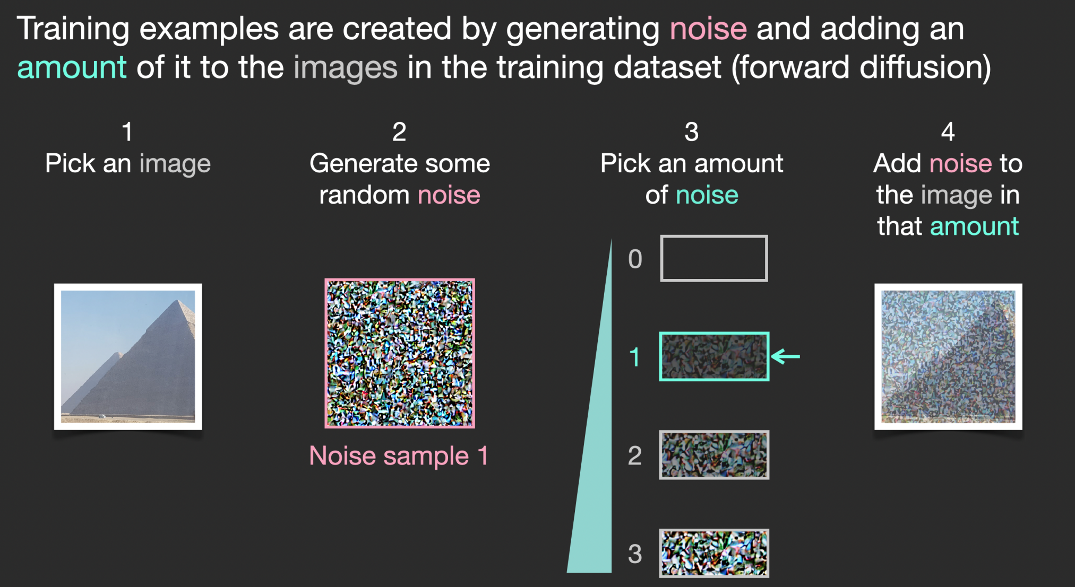
Stable diffusion Training dataset
Image source: https://jalammar.github.io/illustrated-stable-diffusion/

Slide 47
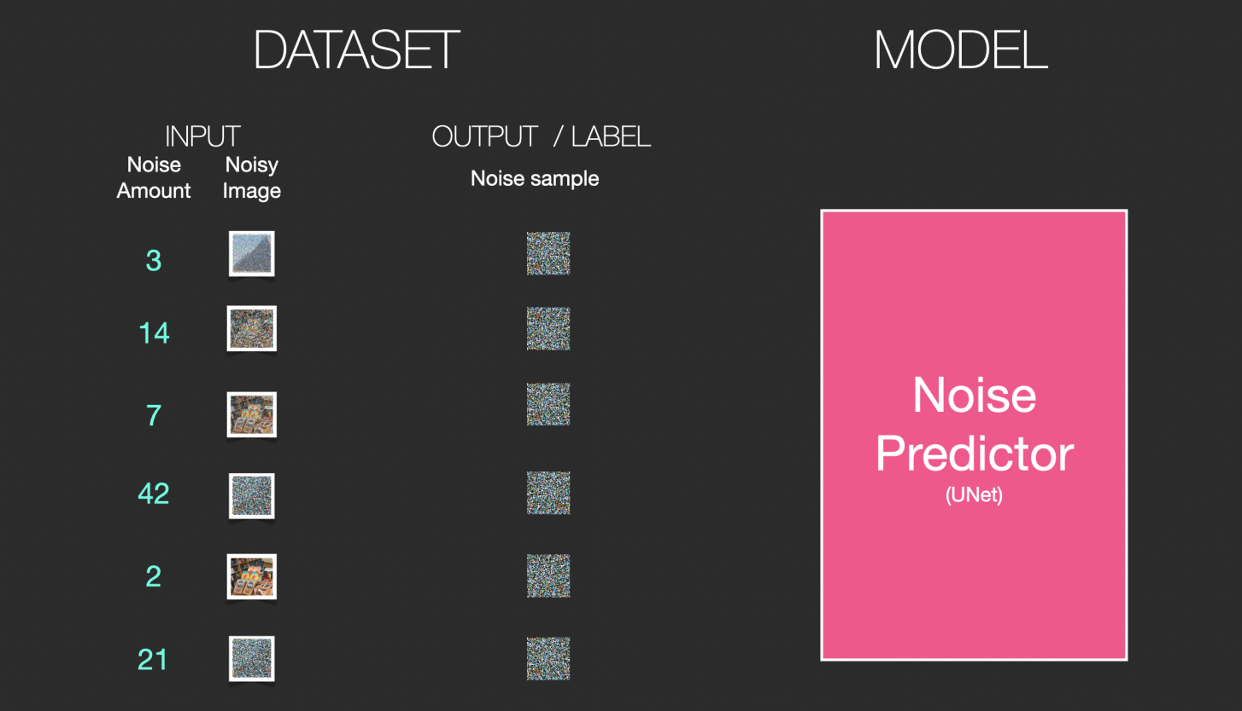
Stable diffusion Training dataset
Supervised flavor:
- Input: noisy image
- Label: amount of noise
Train a UNet to predict this noise amount
Image source: https://jalammar.github.io/illustrated-stable-diffusion/

Slide 48
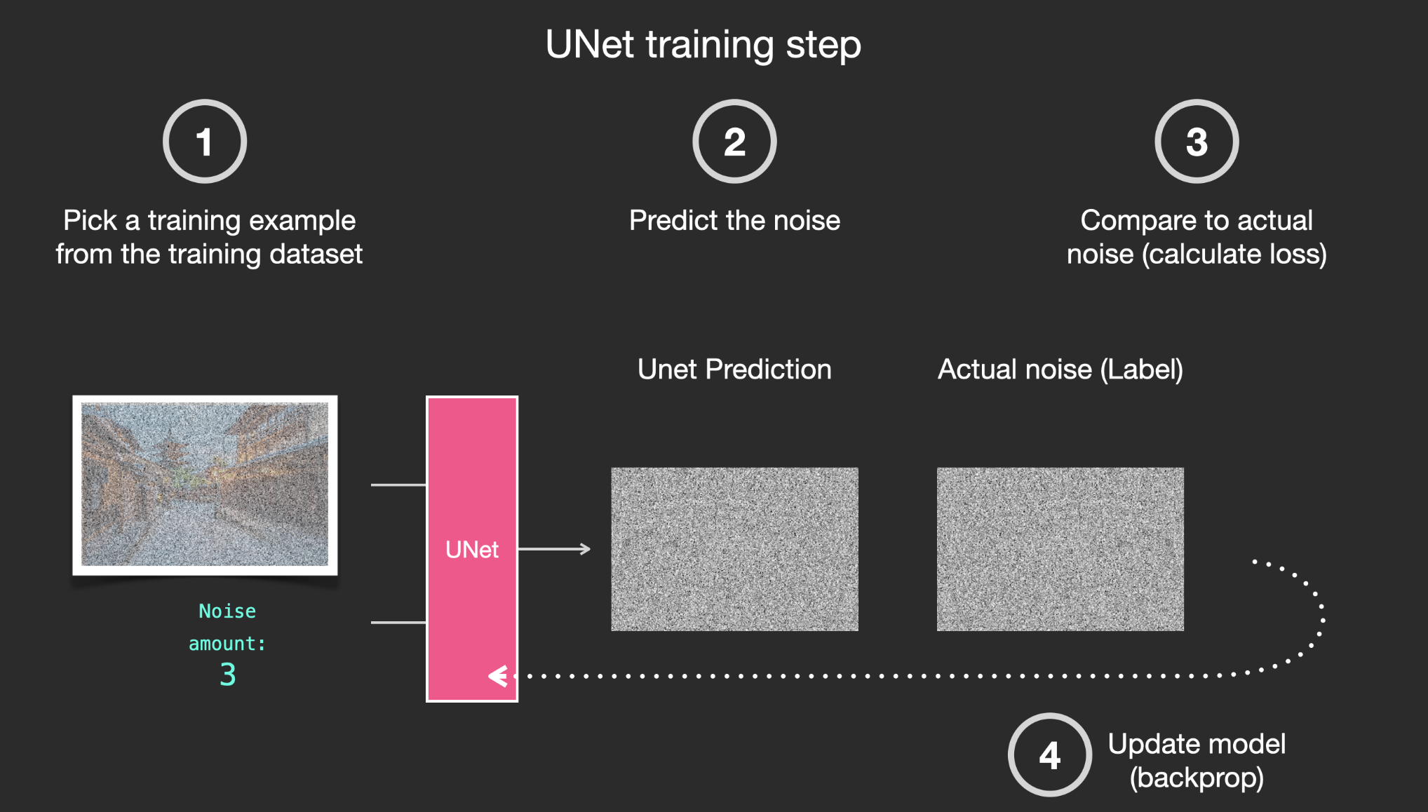
Stable diffusion Training
Image source: https://jalammar.github.io/illustrated-stable-diffusion/

Slide 49
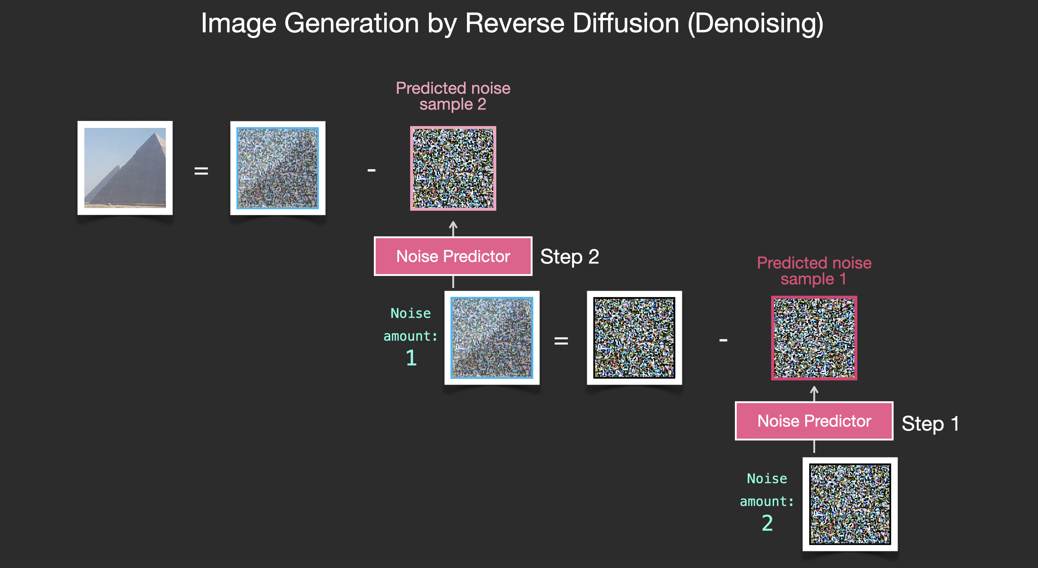
Stable diffusion Reverse diffusion
Image source: https://jalammar.github.io/illustrated-stable-diffusion/

Slide 50
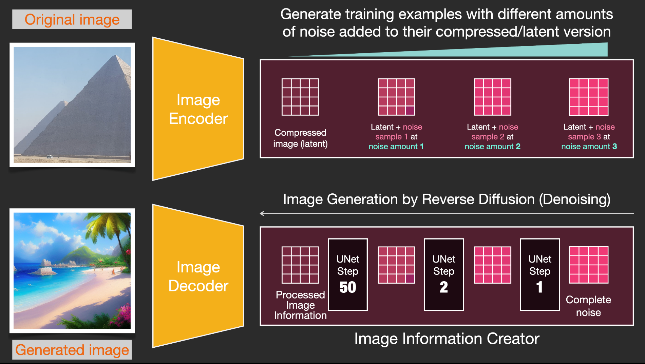
Stable diffusion Overall flow
Image source: https://jalammar.github.io/illustrated-stable-diffusion/

Slide 51
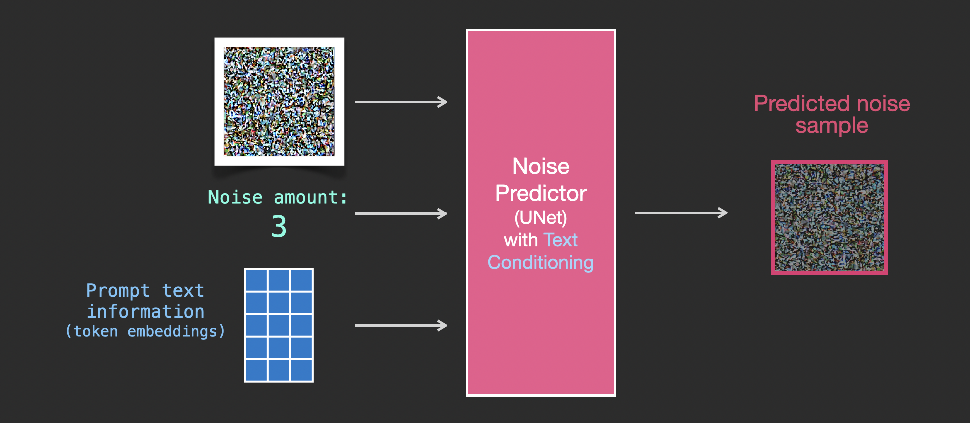
Stable diffusion Overall flow
Image source: https://jalammar.github.io/illustrated-stable-diffusion/

Slide 52
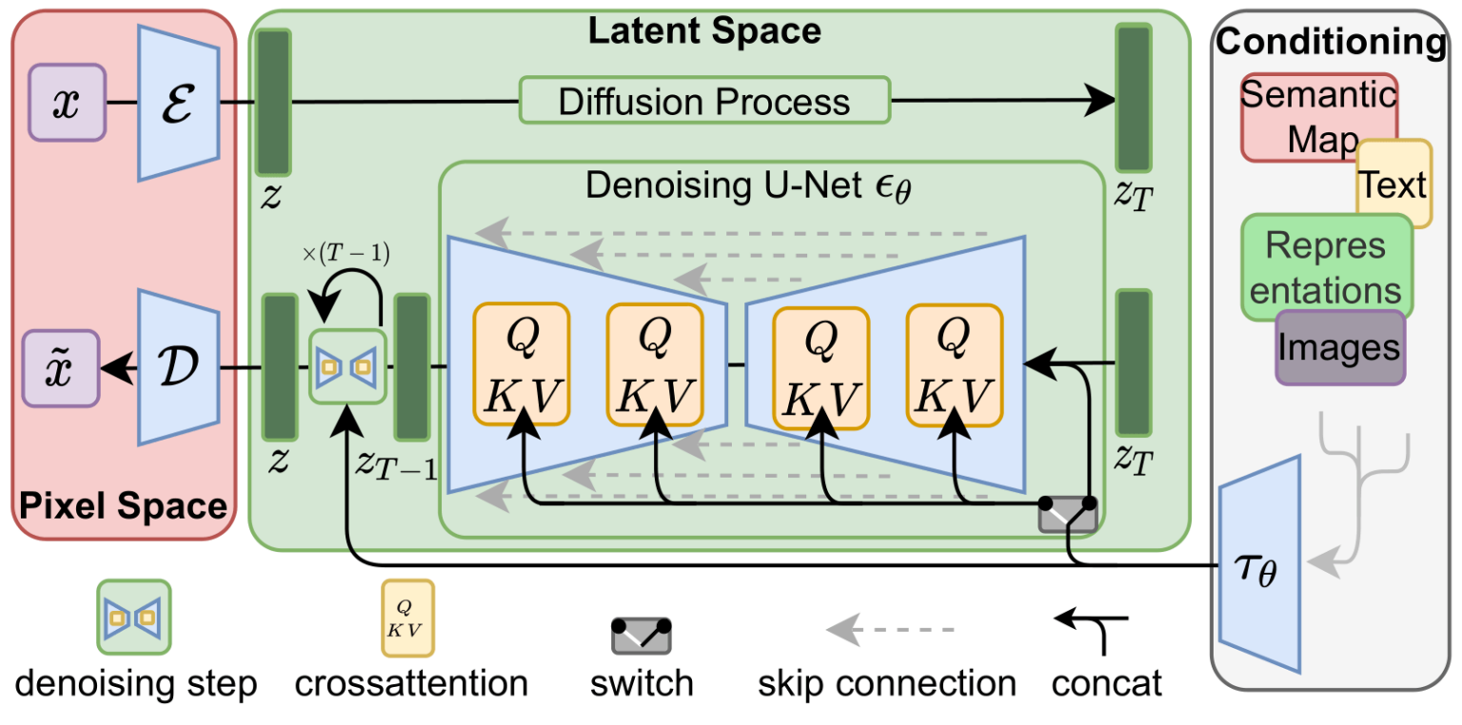
Stable diffusion
Image source: https://arxiv.org/pdf/2112.10752.pdf

Slide 53
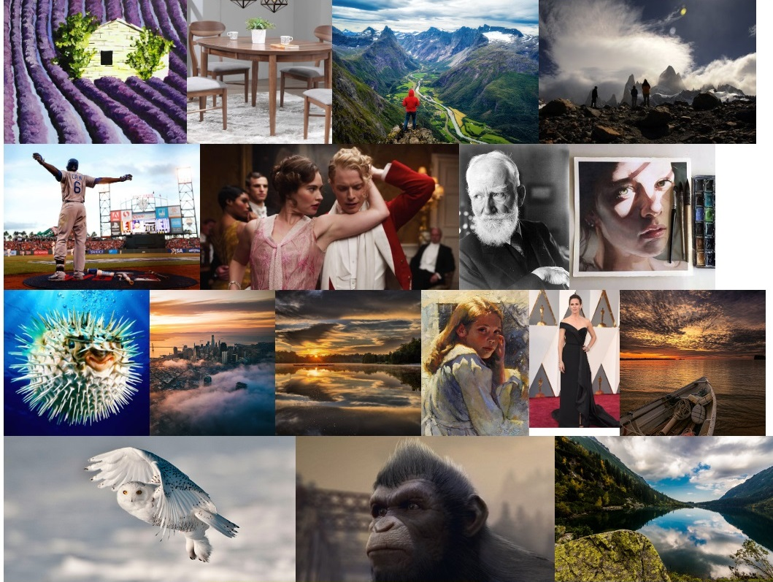
Stable diffusion
LAION dataset
400M English (image, text) pairs

Slide 54
Deep fake detection
https://www.youtube.com/watch?v=poSd2CyDpyA

Slide 55
THE END ☺

